Slide 1
MySQL : Advanced E-Commerce Platform Backend MongoDB : Advanced Social Media Platform Backend
Presented by:
ISFI Abderrahmane
TABCHI Achraf
EL MOTAOUAKKEL Hossam

Slide 2
MySQL
01
MongoDB
Database Creation
01
Database & Collection Setup
02
Creation of Tables
02
Data Insertion
03
Data Insertion
03
Queries and Aggregations
04
Data Verification
04
Data Modifications
05
Database Modifications

Slide 3
MySQL

Slide 4
01
Database Creation
Phase 1:

Slide 5
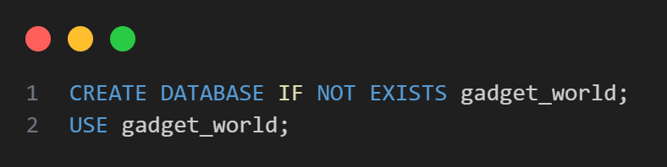
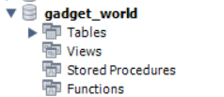
Database Creation
Initializes the main database for Gadget World
All tables and data will be created inside this schema

Slide 6
02
Creation of Tables
Phase 1:

Slide 7
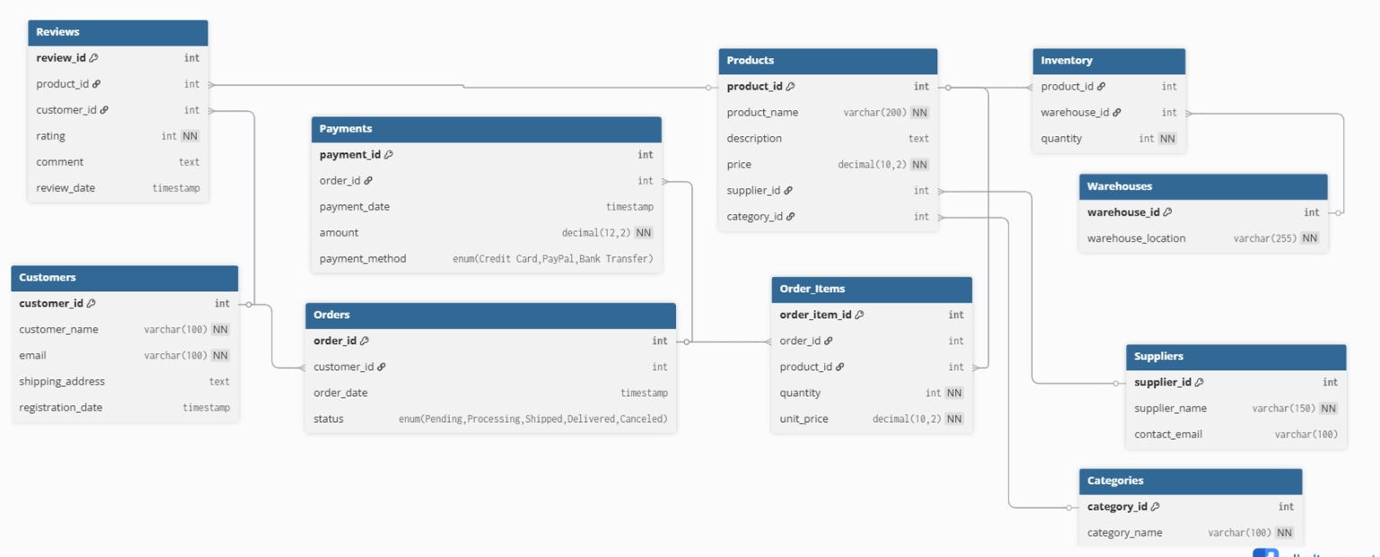
Visual Representation of Tables and Their Relationships

Slide 8
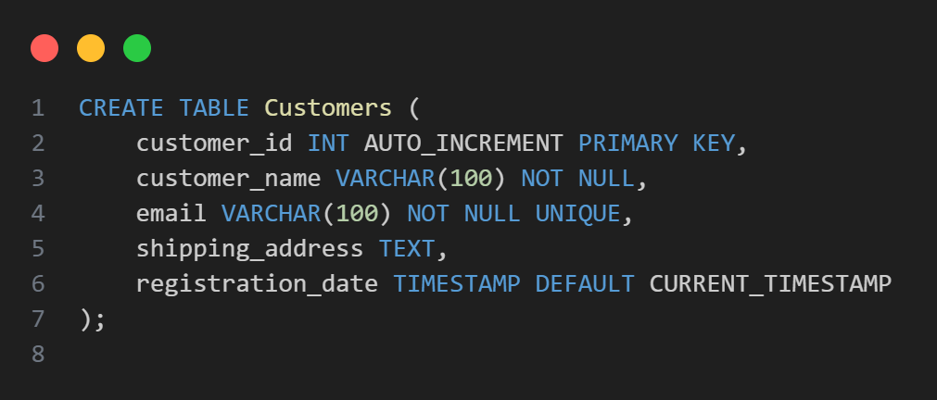
Creation of Tables
1 - Table `Customers`

Slide 9
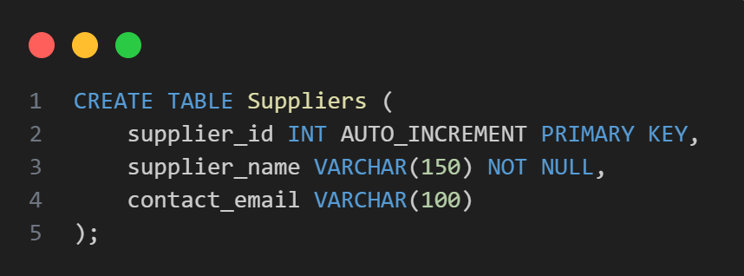
Creation of Tables
2 - Table `Suppliers`

Slide 10
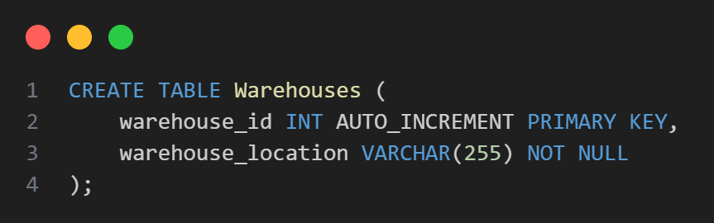
Creation of Tables
3 - Table `Warehouses`

Slide 11
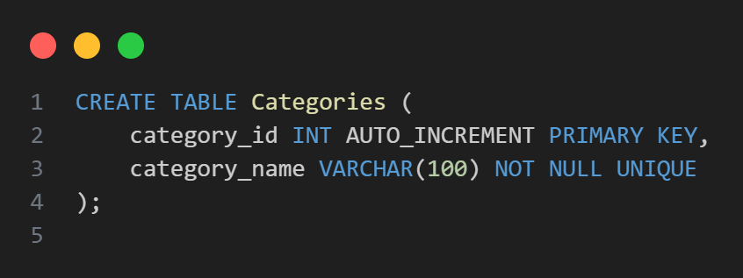
Creation of Tables
4 - Table `Categories`

Slide 12
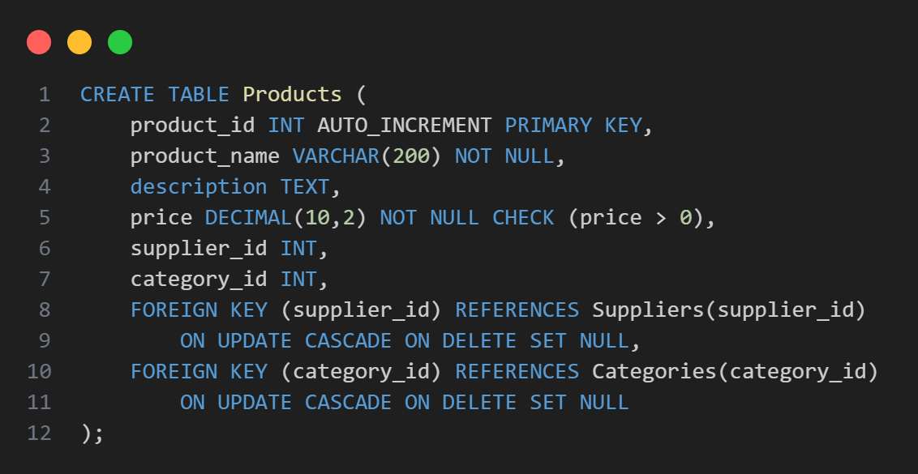
Creation of Tables
5 - Table `Products`

Slide 13
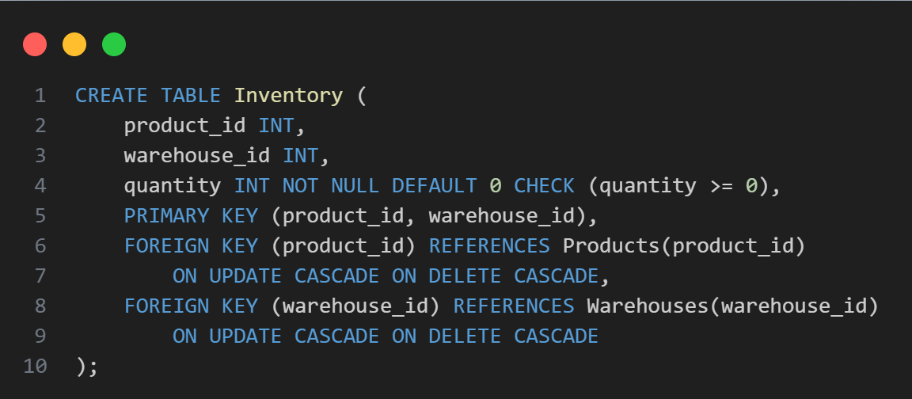
Creation of Tables
6 - Table `Inventory`

Slide 14
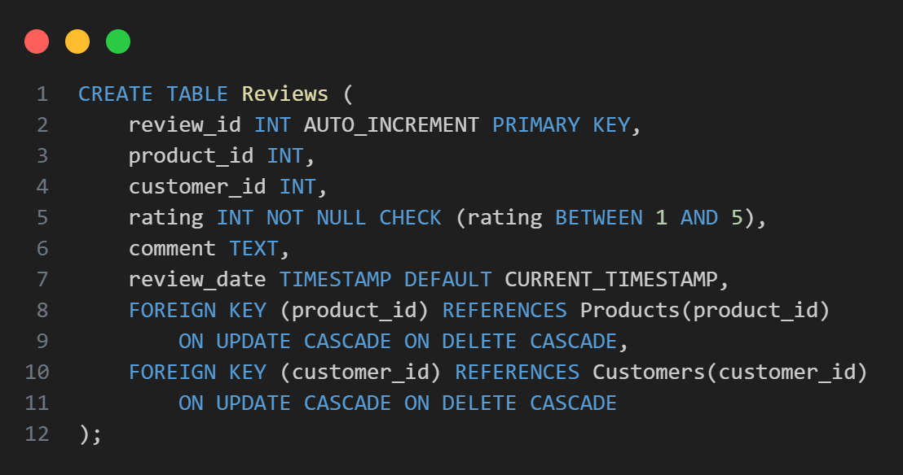
Creation of Tables
7 - Table `Reviews`

Slide 15
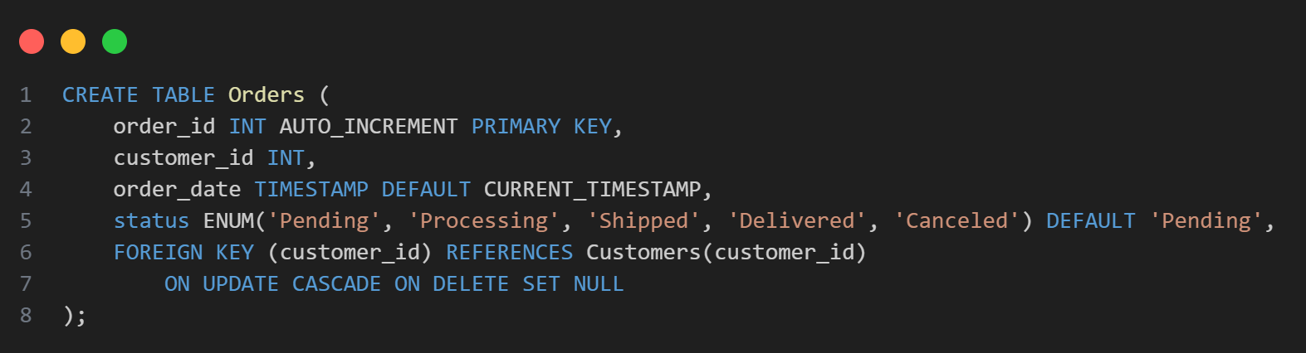
Creation of Tables
8 - Table `Orders`

Slide 16
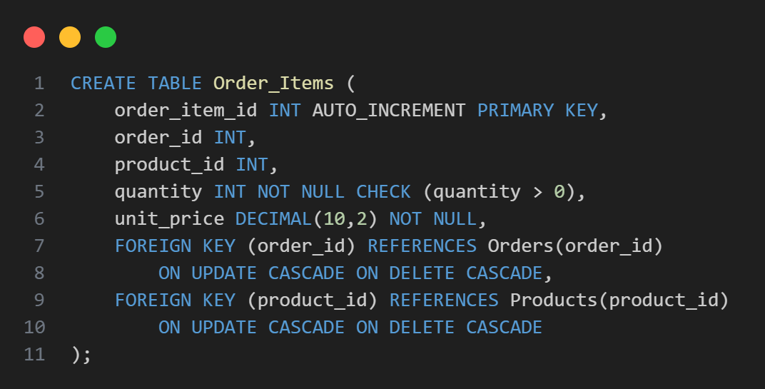
Creation of Tables
9 - Table `Order_Items`

Slide 17
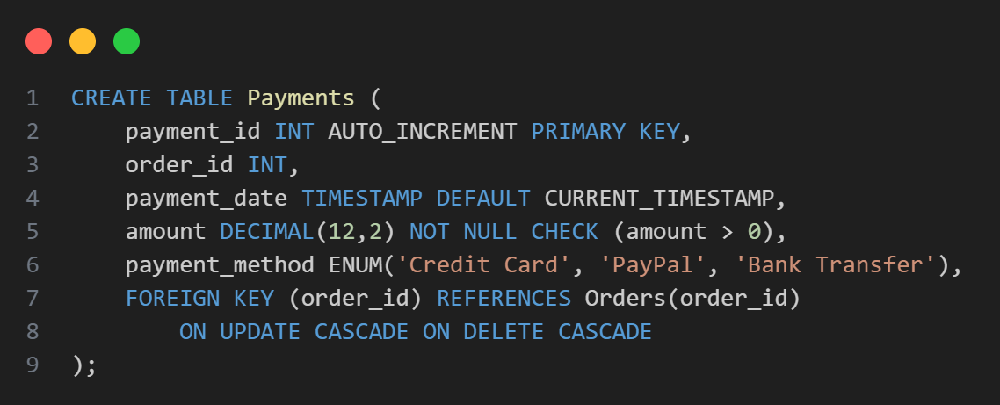
Creation of Tables
10 - Table `Payments`

Slide 18
03
Data Insertion
Phase 2:

Slide 19
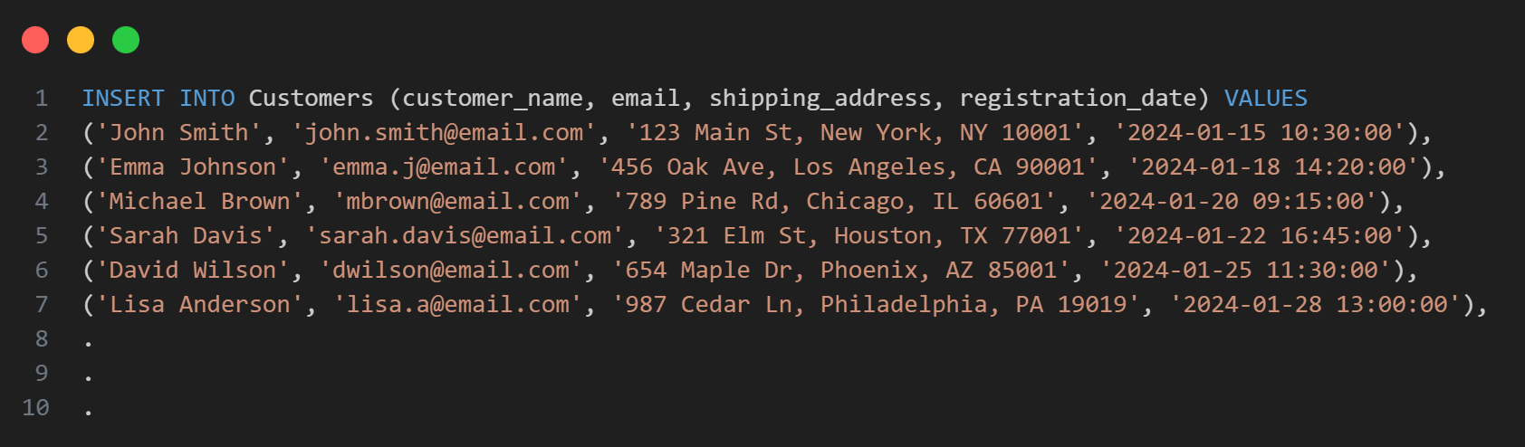
Data Insertion
1 - Table `Customers`

Slide 20
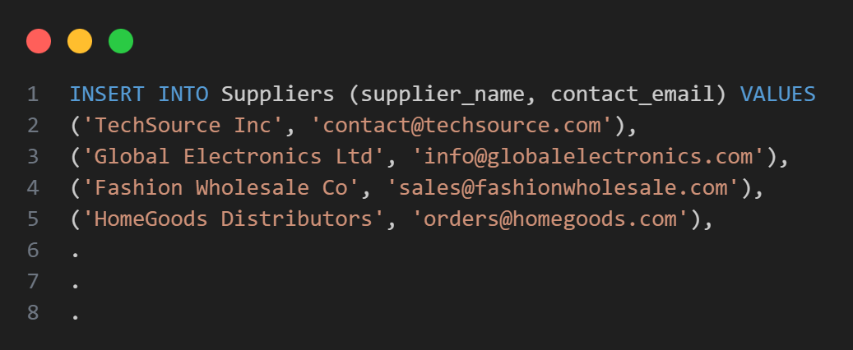
Data Insertion
2 - Table `Suppliers`

Slide 21
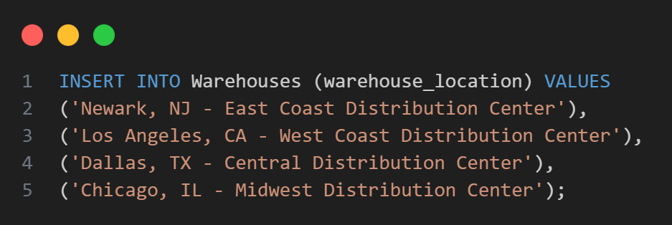
Data Insertion
3 - Table `Warehouses`

Slide 22
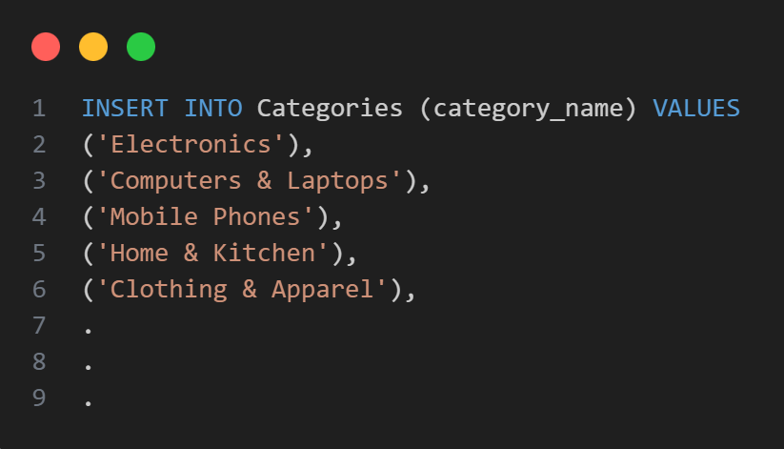
Data Insertion
4 - Table `Categories`

Slide 23
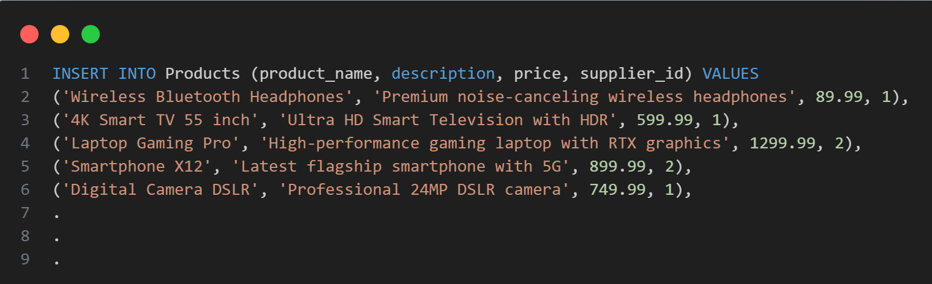
Data Insertion
5 - Table `Products`

Slide 24
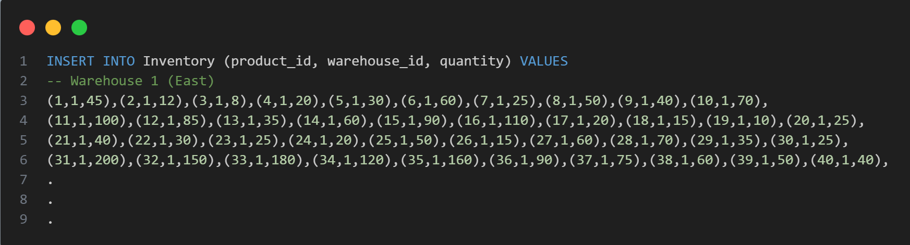
Data Insertion
6 - Table `Inventory`

Slide 25
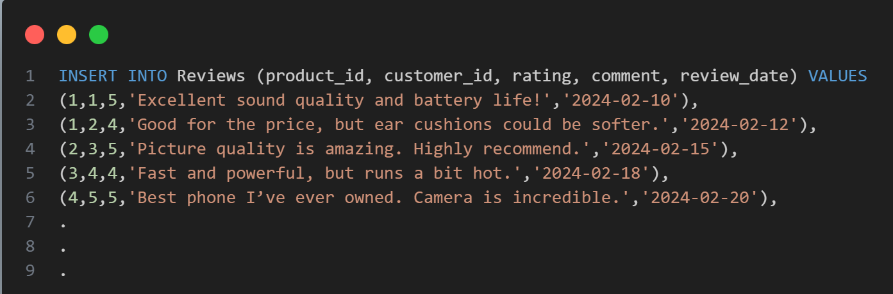
Data Insertion
7 - Table `Reviews`

Slide 26
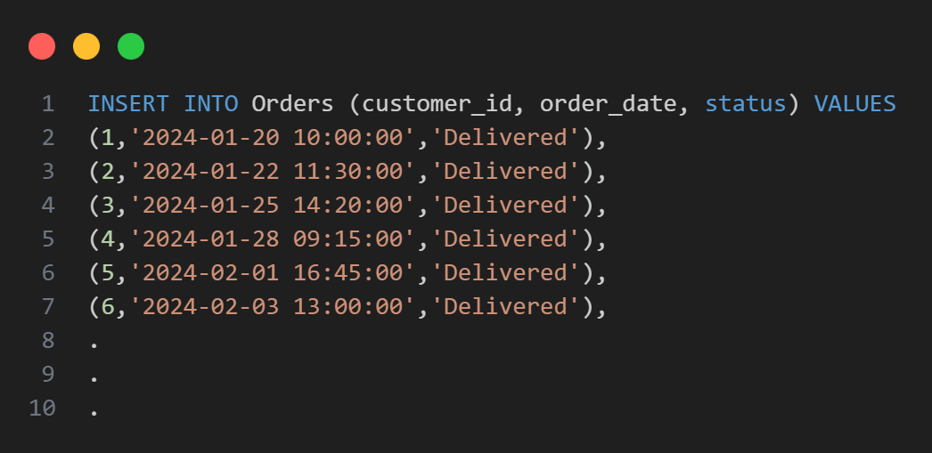
Data Insertion
8 - Table `Orders`

Slide 27
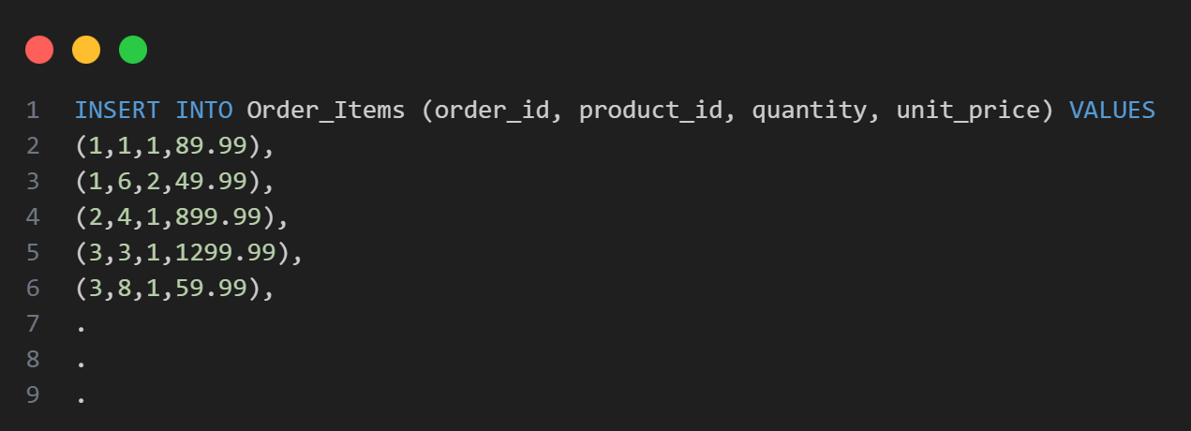
Data Insertion
9 - Table `Order_Items`

Slide 28
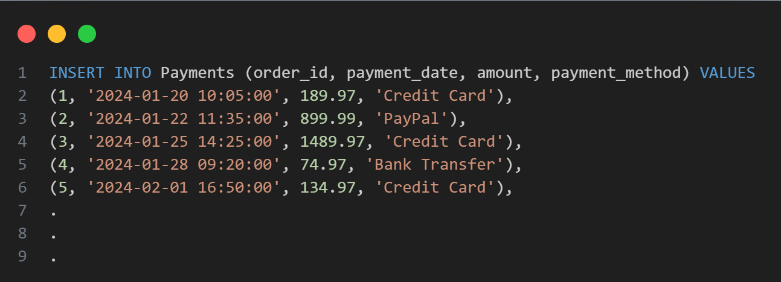
Data Insertion
10 - Table `Payments`

Slide 29
04
Data Verification
Phase 3:

Slide 30
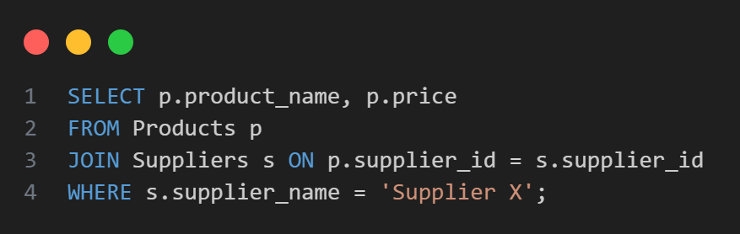
Data Verification
1 - List all products supplied by “Supplier X”

Slide 31
Output:
1 - List all products supplied by “Supplier X”
Product_name | price
Wireless Mouse | 19.99

Slide 32
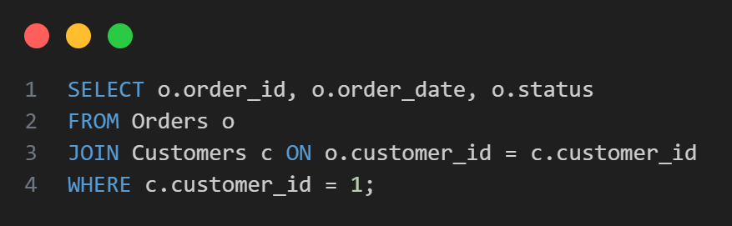
Data Verification
2 - Show full order history of a customer

Slide 33
Output:
2 - Show full order history of a customer
Order_id | order_date | status
1 | 2024-06-02 10:15:00 | Delevered
46 | 2024-04-01 10:00:00 | Delevered
91 | 2024-03-01 10:00:00 | Delevered
136 | 2024-02-05 10:20:00 | Delevered
181 | 2024-01-20 10:00:00 | Shipped
… | … | …

Slide 34
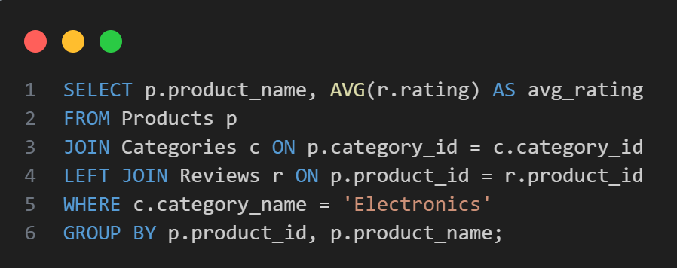
Data Verification
3 - Display “Electronics” products with average rating

Slide 35
Output:
3 - Display “Electronics” products with average rating
Product_name | AVG_rating
'Wireless Bluetooth Headphones' | 2,7500

Slide 36
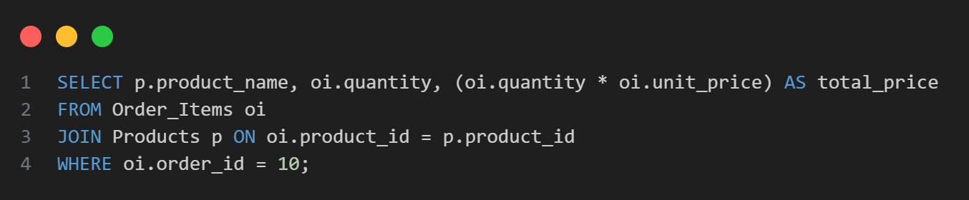
Data Verification
4 - Show items in Order #10 (name, qty, line total)

Slide 37
Output:
4 - Show items in Order #10 (name, qty, line total)
Product_name | quantity | Total_price
Facial Moisturizer Cream | 1 | 29.99
Shampoo Organic | 1 | 18.99
Electric Toothbrush | 1 | 79.99
Car Floor Mats | 1 | 199.99

Slide 38
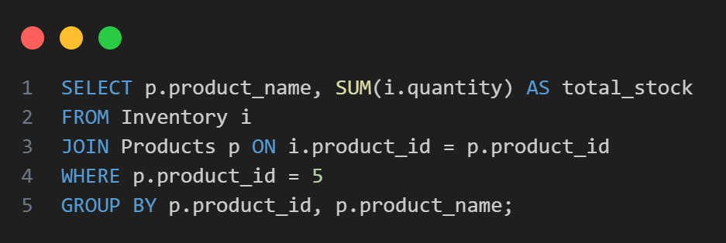
Data Verification
5 - Find total stock quantity across warehouses

Slide 39
Output:
5 - Find total stock quantity across warehouses
Product_name | Total_stock
Digital camera DSLR | 65

Slide 40
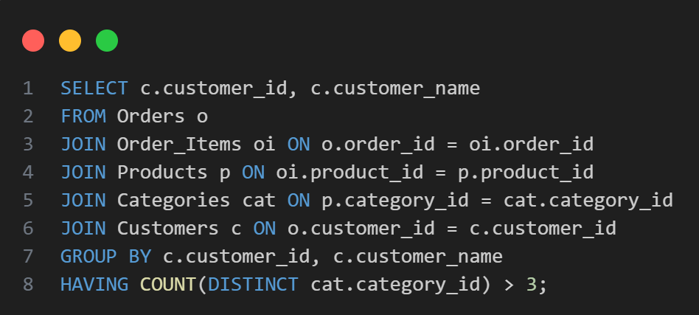
Data Verification
6 - Customers who purchased from > 3 categories

Slide 41
Output:
6 - Customers who purchased from > 3 categories
Cunstomer_id | Customer_name
1 | John Smith
2 | Emma Johnson
3 | Michael Brown
7 | James Taylor

Slide 42
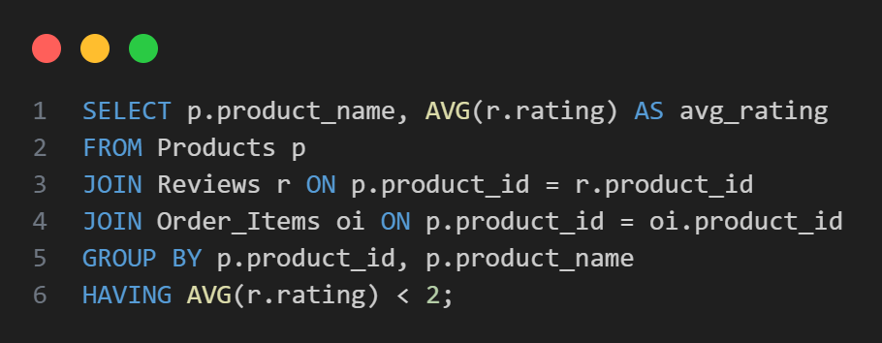
Data Verification
7 - Products rated < 2 stars but sold at least once

Slide 43
Output:
7 - Products rated < 2 stars but sold at least once
Product_name | Avg_rating
none

Slide 44
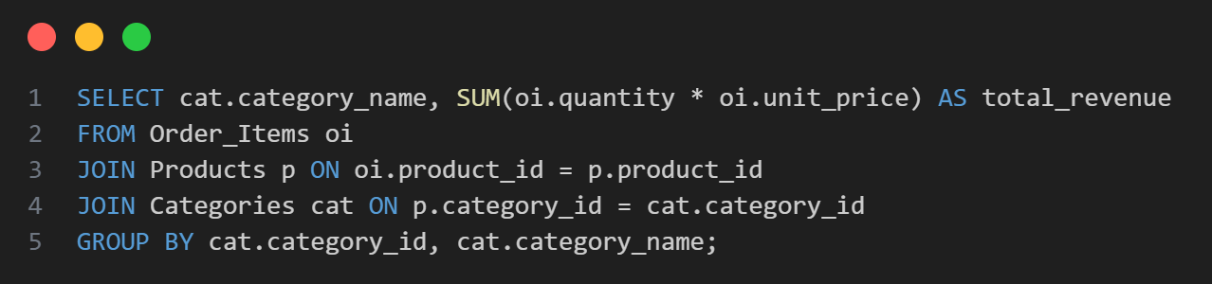
Data Verification
8 - Total revenue generated by each category

Slide 45
Output:
8 - Total revenue generated by each category
category_name | total_revenue
Electronics | 719.92
Computers & Laptops | 3649.93
Mobile Phones' | 10399.92
Home & Kitchen | 1199.94
… | …

Slide 46
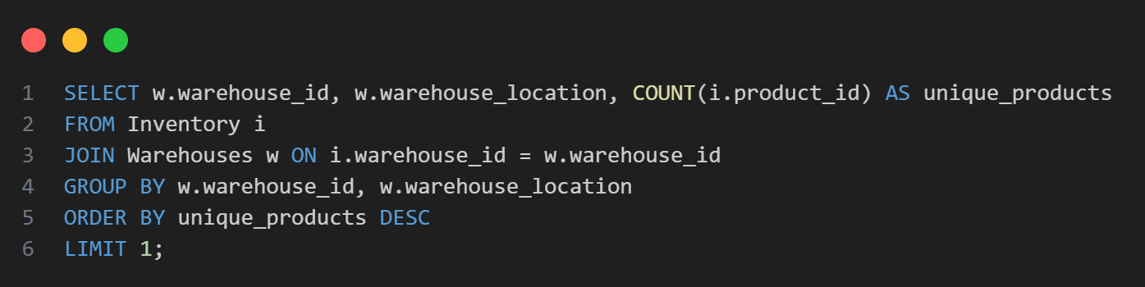
Data Verification
9 - Warehouse with most unique products

Slide 47
Output:
9 - Warehouse with most unique products
warehouse_id | warehouse_location | unique_products
1 | Newark, NJ - East Coast Distribution Center | 50

Slide 48
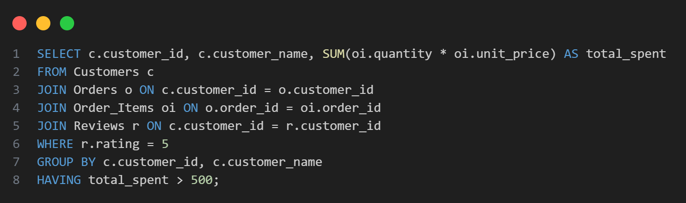
Data Verification
10 - Customers spending > $500 and giving ≥ 1 five-star review

Slide 49
Output:
10 - Customers spending > $500 and giving ≥ 1 five-star review
customer_id | customer_name | total_spent
1 | John Smith | 16679.16
2 | Emma Johnson | 3994.88
3 | Michael Brown | 21335.36
4 | Sarah Davis | 643.85
5 | David Wilson | 9974.58
6 | James Taylor | 4229.88
… | … | …

Slide 50
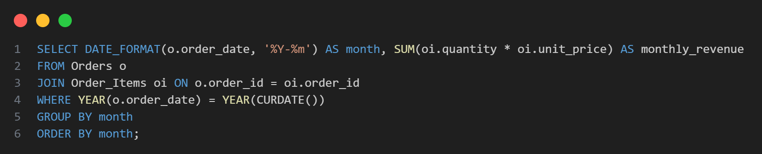
Data Verification
11 - Revenue per month for current year

Slide 51
Output:
11 - Revenue per month for current year
mounth | Mounthly_revenu
2025-10 | 269.96

Slide 52
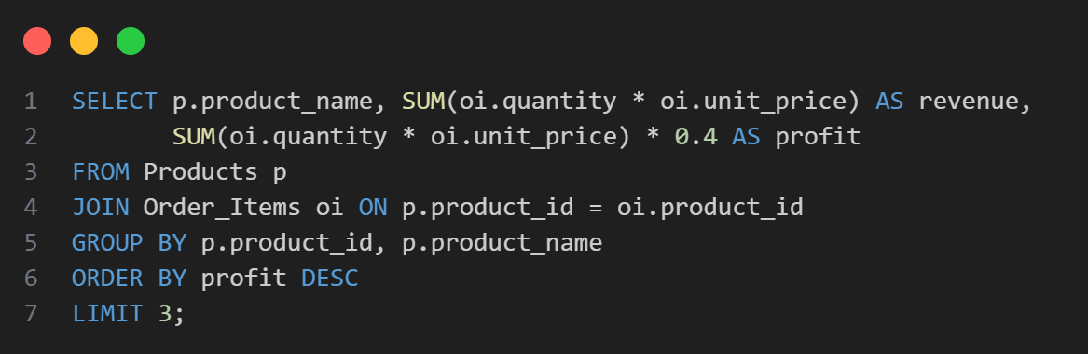
Data Verification
12 - Top 3 products by profit (revenue – cost)

Slide 53
Output:
12 - Top 3 products by profit (revenue – cost)
Product_name | revenue | profit
Laptop Gaming Pro | 10399.92 | '4159.968
Smartphone X12 | 6299.93 | '2519.972
Digital Camera DSLR | 5249.93 | '2099.972

Slide 54
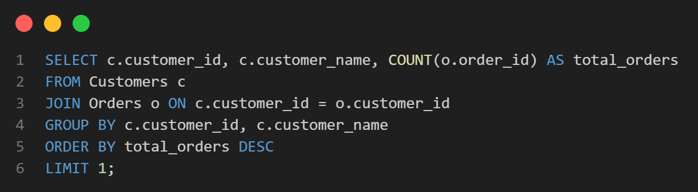
Data Verification
13 - Customer who placed the most orders

Slide 55
Output:
13 - Customer who placed the most orders
Customer_id | Customer_name | total_orders
1 | John Smith | 8

Slide 56
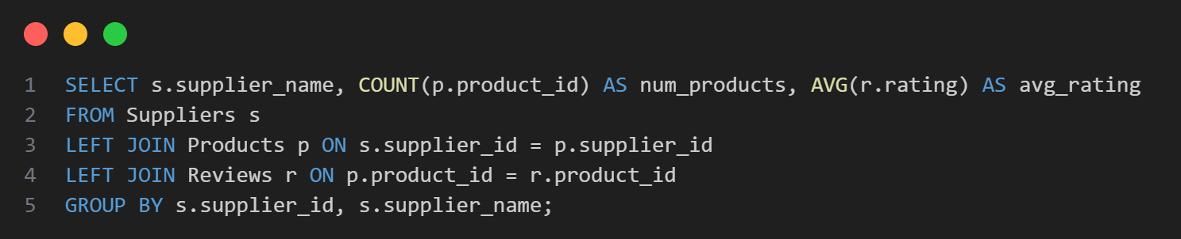
Data Verification
14 - Suppliers with #products and avg. ratings

Slide 57
Output:
14 - Suppliers with #products and avg. ratings
Sipplier-name | Num_products | AVG_rating
TechSource Inc | 32 | '3.5667'
Global Electronics Ltd | 10 | 3.8000
Fashion Wholesale Co | 16 | 4.3750
HomeGoods Distributors | 45 | 4.4444
Sports Equipment Pro | 7 | 4.7143
… | … | …

Slide 58
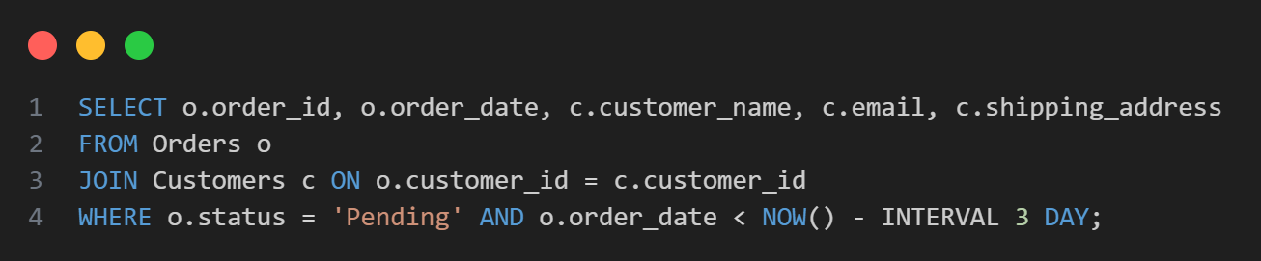
Data Verification
15 - Pending orders > 3 days with customer contact info

Slide 59
Output:
15 - Pending orders > 3 days with customer contact info
order_id | Order_date | Customer_name | email | Shopping_addresse
63 | 2024-04-15 09:35:00 | Susan Young | syoung@email.com | 147 Redwood Ave, Seattle, WA 98101
64 | 2024-04-18 16:50:00 | Joseph Hall | jhall@email.com | 258 Cypress St, Denver, CO 80201
200 | '2024-07-15 11:30:00' | Gary Murphy | gmurphy@email.com | 963 Pinewood Dr, Minneapolis, MN 55401

Slide 60
05
Database Modifications
Phase 4:

Slide 61
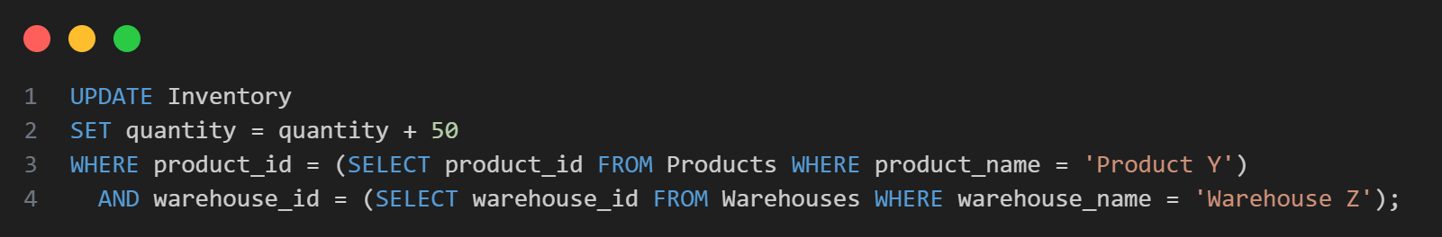
Database Modifications
1 - Update Inventory – Shipment of 50 units of 'Product Y' arrives at 'Warehouse Z'

Slide 62
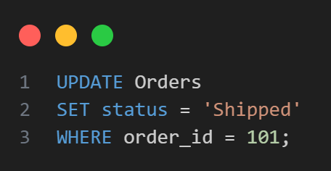
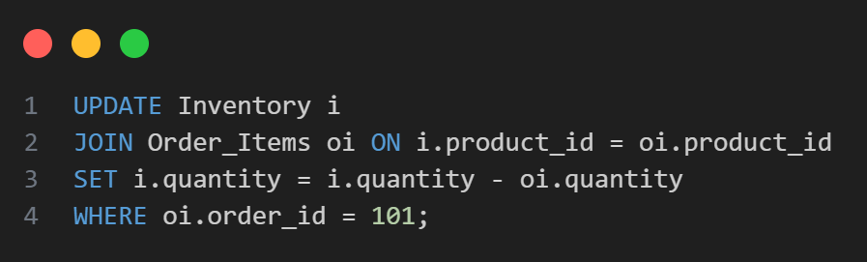
Database Modifications
2 - Update Order Status & Stock – An order has been shipped:

Slide 63
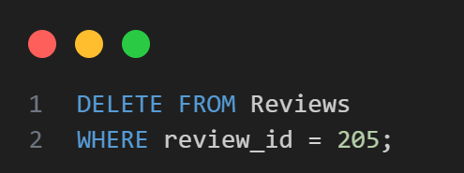
Database Modifications
3 - Delete Spam Review – Remove flagged review:

Slide 64
MongoDB

Slide 65
01
Database & Collection Setup
Phase 1:

Slide 66
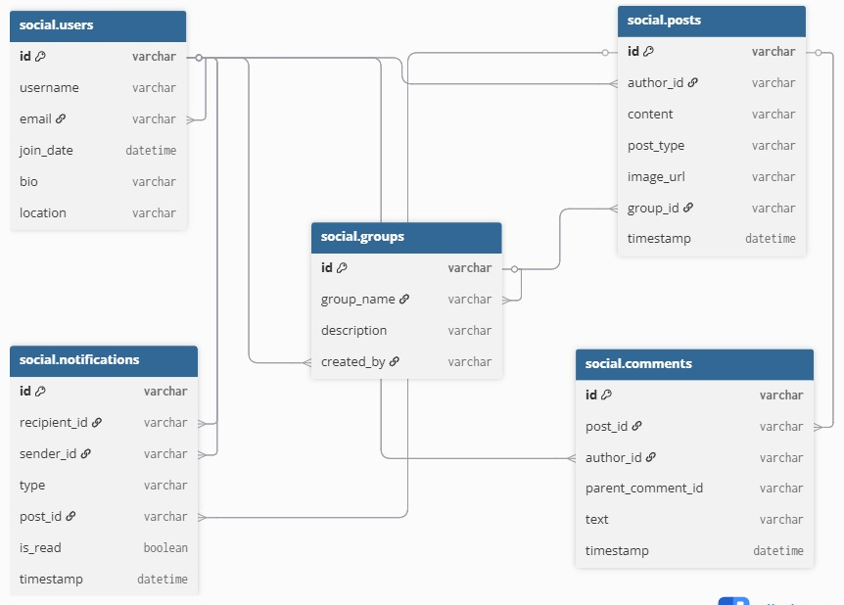
Visual Representation of Tables and Their Relationships

Slide 67
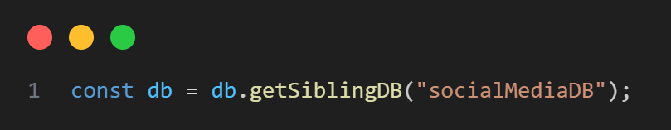

Creating the Database
Initialize the MongoDB database for the social media platform.
This command switches to the socialMediaDB database, which will be created the moment we insert our first document.

Slide 68
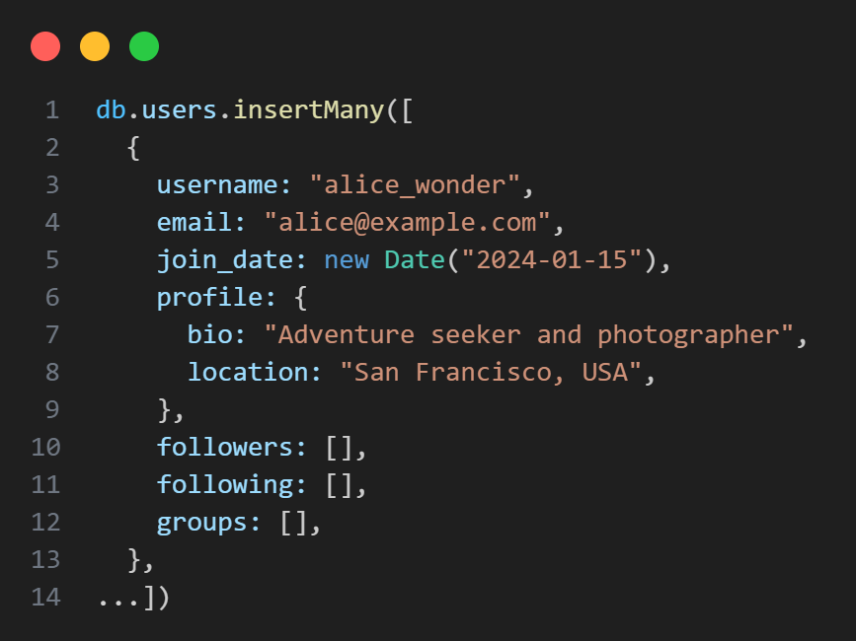
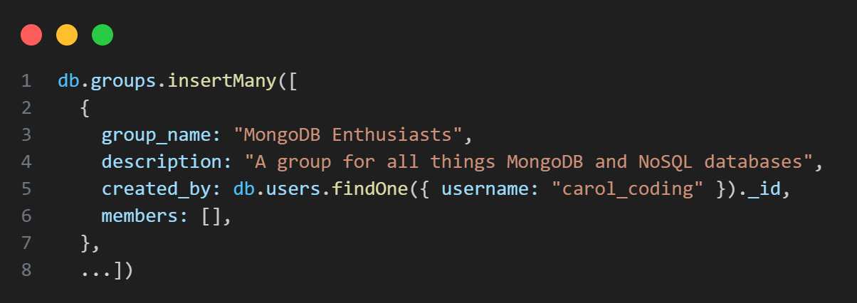
Inserting Base Data
Inserting Base Data with ”insertMany()”
Users:
Groupes:

Slide 69
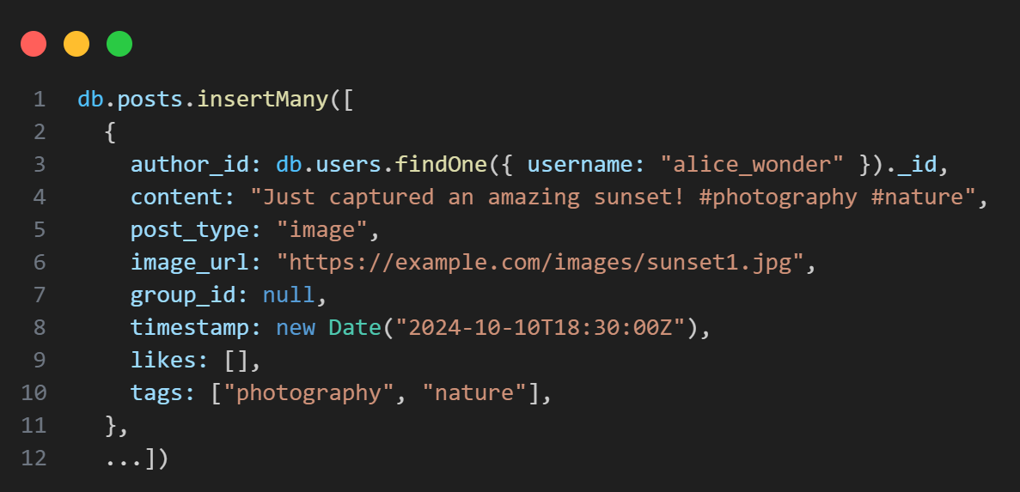
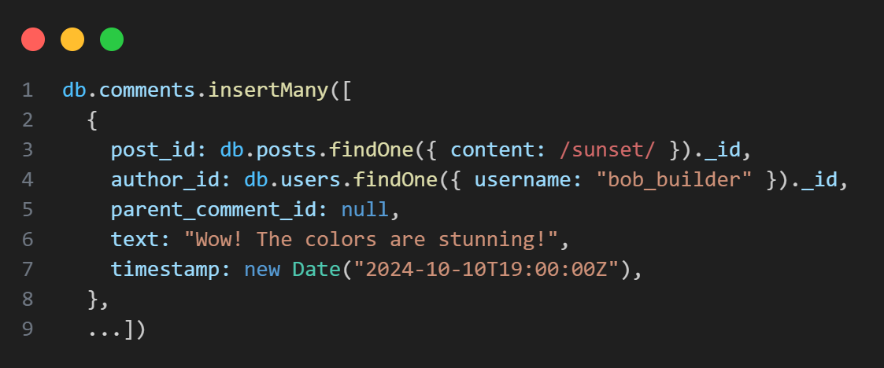
Inserting Base Data
Inserting Base Data with ”insertMany()”
Posts:
Comment:

Slide 70
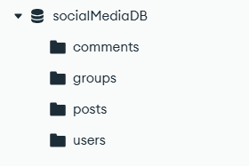
Inserting Base Data
Collections Created Implicitly:

Slide 71
02
Data Insertion
Phase 2:

Slide 72
01
Insert additional users & Create more groups

Slide 73
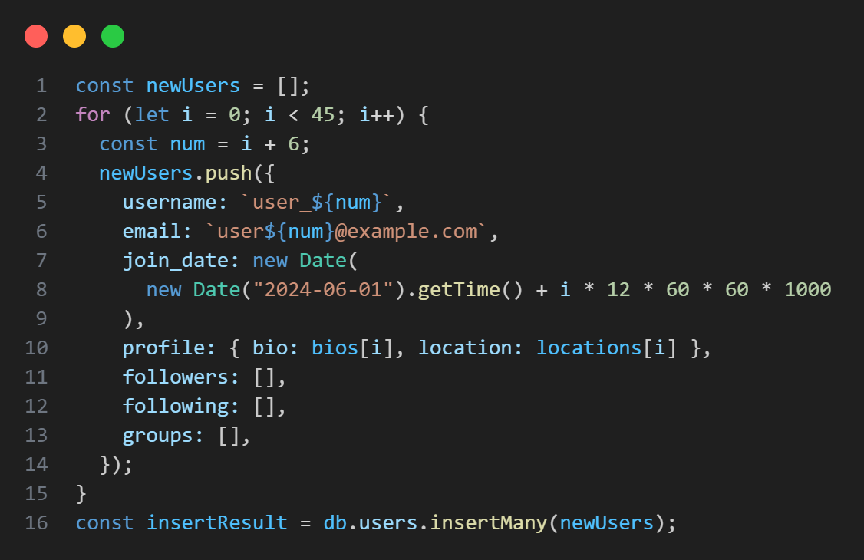
Insert additional users
Insert 45 additional users

Slide 74


Create more groups
Create specialized groups

Slide 75
02
Build social graph (followers/following)

Slide 76

Build social graph(followers/following)
Helper function for random connections

Slide 77


Build social graph(followers/following)
Update user followers/following

Slide 78
03
Assign users to groups

Slide 79

Assign users to groups
Organizing Users into Communities

Slide 80

Assign users to groups
Example: JavaScript Developers group

Slide 81
04
Create posts with engagement

Slide 82


Create posts with engagement
Recent Posts (Last 24 hours)

Slide 83
03
Queries and Aggregations
Phase 1:

Slide 84

Queries and Aggregations
1 - Find the complete profile of a user, and using $lookup, retrieve full documents of users they are following

Slide 85

Queries and Aggregations
2 - List all posts made within a specific group

Slide 86

Queries and Aggregations
3 - For a specific post, retrieve all its parent comments. Then for a specific parent comment, retrieve all replies

Slide 87

Queries and Aggregations
4 - Find all posts from the last 24 hours that contain the tag '#mongodb'

Slide 88


Queries and Aggregations
5 - Generate an Advanced User Feed: posts from followed users AND group posts, sorted by timestamp, limit 20

Slide 89

Queries and Aggregations
6 - Identify users who are members of a group but have never posted in it

Slide 90

Queries and Aggregations
7 - Find posts that have more than 10 likes but zero comments

Slide 91

Queries and Aggregations
8 - ount the number of members in each group

Slide 92


Queries and Aggregations
9 - Generate a list of unread notifications for a user

Slide 93

Queries and Aggregations
10 - List the top 10 most influential users (most followers)

Slide 94


Queries and Aggregations
11 - Calculate the average number of likes per post for each user

Slide 95


Queries and Aggregations
12 - Find the 'trending' tags of the day by counting tag occurrences in posts from the last 24 hours

Slide 96


Queries and Aggregations
13 - Find the most active user in a specific group (most posts + comments)

Slide 97

Queries and Aggregations
14 - Generate a report showing the daily user registration count for the last 30 days

Slide 98

Queries and Aggregations
15 - For a user's profile, aggregate total post count, total likes received, and follower count

Slide 99
04
Data Modifications
Phase 4:

Slide 100

Queries and Aggregations
1 - A user follows another: use `$addToSet` on both users' documents to update `following` and `followers` arrays. Then, create a `notification` document.

Slide 101

Queries and Aggregations
A user posts a reply to a comment: create a new `comment` document with the `parent_comment_id` set correctly. Then, create a `notification` for the author of the parent comment.

Slide 102

Queries and Aggregations
A user joins a group: add the user's ID to the group's `members` array and the group's ID to the user's `groups` array

Slide 103
Thank You ☺

